Slide 1
Theory of NP Completeness
Oswald c
The class notes are a compilation and edition from many sources by materials from CLRS, Anany Levitin, Richard Anderson, etc. The faculty does not claim intellectual property or ownership of the lecture notes. Thanks to them!

Slide 2
NP-Completeness
So far we’ve seen a lot of good news!
  Such-and-such a problem can be solved quickly (i.e., in close to linear time, or at least a time that is some small polynomial function of the input size)
NP-completeness is a form of bad news!
  Evidence that many important problems can not be solved quickly.
NP-complete problems really come up all the time!

Slide 3
Why should we care?
Knowing that they are hard lets you stop beating your head against a wall trying to solve them…
  Use a heuristic: come up with a method for solving a reasonable fraction of the common cases.
  Solve approximately: come up with a solution that you can prove that is close to right.
  Use an exponential time solution: if you really have to solve the problem exactly and stop worrying about finding a better solution.

Slide 4
Solvable and Unsolvable problems
Computational problems can be broadly classified into solvable and unsolvable problems.
Solvable problems are problems that have an algorithm running in finite time whereas for unsolvable problems, every algorithm takes infinite time to complete.
E.g. printing all natural numbers, Sorting,
printing all real numbers, searching,
halting problem etc.
An algorithm exists(Recall that, by definition, any algorithm must terminate after a infinite amount of time.)

Slide 5
Optimization & Decision Problems
Decision problems
  Given an input and a question regarding a problem, determine if the answer is yes or no
Optimization problems
  Find a solution with the “best” value
Optimization problems can be cast as decision problems that are easier to study
  E.g.: Shortest path: G = unweighted directed graph
    Find a path between u and v that uses the fewest edges
    Does a path exist from u to v consisting of at most k edges?

Slide 6
Algorithmic vs Problem Complexity
The algorithmic complexity of a computation is some measure of how difficult is to perform the computation (i.e., specific to an algorithm)
The complexity of a computational problem or task is the complexity of the algorithm with the lowest order of growth of complexity for solving that problem or performing that task.
  e.g. the problem of searching an ordered list has at most lgn time complexity.
Computational Complexity: deals with classifying problems by how hard they are.

Slide 7
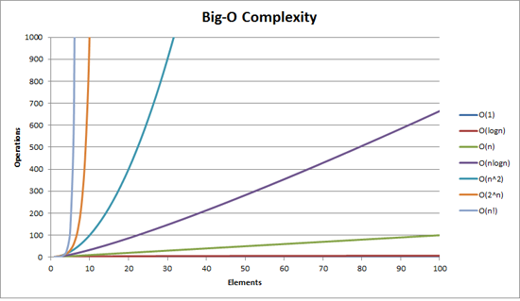
How bad is exponential complexity
Fibonacci example – the recursive fib cannot even compute fib(50)

Slide 8
Class of “P” Problems
Class P consists of (decision) problems that are solvable in polynomial time
Polynomial-time algorithms
  Worst-case running time is O(n^{k}), for some constant k
Examples of polynomial time:
  O(n²), O(n³), O(1), O(n lg n)
Examples of non-polynomial time:
  O(2^{n}), O(n^{n}), O(n!)

Slide 9


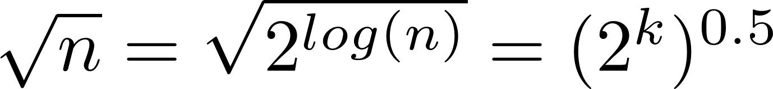
What is the complexity of primality testing?
public static boolean isPrime(int n){
boolean answer = (n>1)? true: false;
for(int i = 2; i*i <= n; ++i)
{
System.out.printf("%d\n", i);
if(n%i == 0)
{
answer = false;
break;
}
}
return answer;
}
This loops until the square root of n
So this should be
But what is the input size?
How many bits does it take to represent the number n?
log(n) = k
What is
Naïve primality testing is exponential!!

Slide 10
Why obsess about primes?
Crypto uses it heavily
Primality testing actually is in P
Proven in 2002
  Uses complicated number theory
  AKS primality test

Slide 11
Tractable/Intractable Problems
Problems in P are also called tractable
  A problem is tractable if there exists a polynomial-time algorithm.
Problems not in P are intractable or unsolvable
- every algorithm for such problems incurs Ω(c^{n}), c>1.
  Can be solved in reasonable time only for small inputs eg. Enumeration of all subsets of a set of size n, permutation problem in DA1.
  Or, can not be solved at all. E.g.
Are non-polynomial algorithms always worst than polynomial algorithms?
  - n^{1,000,000} is technically tractable, but really impossible
  - n^{log log log n} is technically intractable, but easy

Slide 12
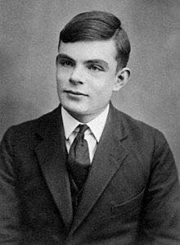
Example of Unsolvable Problem
Alan Turing discovered in 1936 that there are problems unsolvable by any algorithm.
The most famous of them is the halting problem
  Given an arbitrary algorithm and its input, will that algorithm eventually halt, or will it continue forever in an “infinite loop?”
  The answer is NO. The only way is to run the program and check whether it halts or not.
  We can refrain the halting problem question in such a way also: Given a program written in some programming language(c/c++/java) will it ever get into an infinite loop(loop never stops) or will it always terminate(halt)?
  Consider the python program:
  x = input()
  while x:
  pass
Alan M. Turing

Slide 13
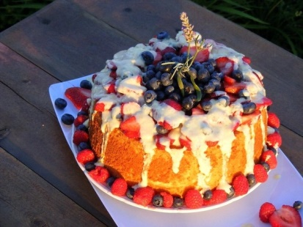

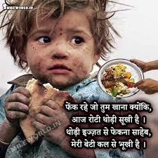
Few other unsolvable problems
Factorization of a large number ‘N’. N being 600 digits.
If you do find a way to factor a number such as N quickly, tell no one but me. I’ll get my lawyers to head over to the National Security Agency (NSA), and inform them that we have a fast way to factor. But we would not dream of just posting it on the Internet. We are just ask for $100,000,000 for our factoring algorithm, and we will promise not to tell anyone else about it. They will pay it, and we’ll be good, rich patriots.
Envy free cake-cutting problem.
Can you compute the beauty of this rose?
Can you design an algorithm to measure
how hungry, this cute baby is?

Slide 14
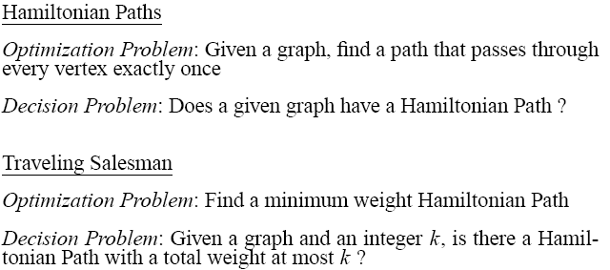
Examples of Intractable Problems

Slide 15
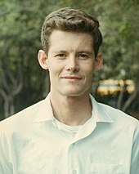
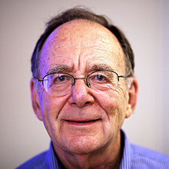
Intractable Problems
Can be classified in various categories based on their degree of difficulty, e.g.,
  NP
  NP-complete
  NP-hard
  The concept of NP-completeness was developed in the late 1960s and early 1970s in parallel by researchers in the US and the USSR. In the US in 1971, Stephen Cook published his paper. Richard Karp's subsequent work generated renewed interest in Cook's paper by providing a list of 21 NP-complete problems. Cook and Karp received a Turing Award for this work.
Let’s define NP algorithms and NP problems …
Cook in 1968
Richard M. Karp

Slide 16
A Hierarchy of Problems
For a given problem, is there or will there ever be an algorithmic solution?
Problem In Theory In Application
Highly Undecidable NO NO
Partially Undecidable NO NO
Intractable YES NO
Tractable YES YES

Slide 17
Deterministic Algorithms
Defn: For a given particular input, the computer will always produce the same output going through the same states.
These algorithm make exactly one move at each step of the computation.
For example, linear search, compares x with A[1] in Step 1 and compares x with A[2] and so on. Further, the underlying computational graph appears like a path.
This is the case with all deterministic algorithms irrespective of whether it runs in polynomial time or exponential time complexity.

Slide 18
Nondeterministic and NP Algorithms
The Turing Machine takes at most O(n^{c}) steps on each computation path
to accept a string of length n.
NP algorithms (Nondeterministic polynomial) = two stage procedure:
Nondeterministic (“guessing”) stage:
  generate randomly an arbitrary string that can be thought of as a candidate solution(“certificate”) in constant time.
Deterministic (“verification”) stage:
  take the certificate and the instance to the problem and returns YES if
  the certificate represents a solution - verification stage is polynomial.
  It is important to note that non-deterministic machine is a hypothetical machine (cannot be realized in practice)

Slide 19

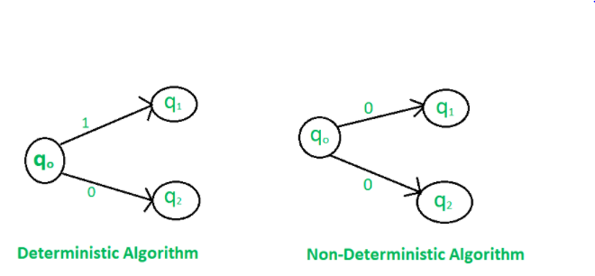
Deterministic and Non-Deterministic Algorithms

Slide 20
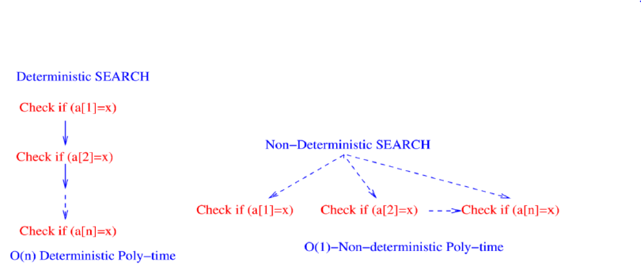
Deterministic and Non-Deterministic Algorithm – An E.g.

Slide 21
E.g. Non-deterministic Linear search.
Input: Array A, key x. Check whether x ∈ A.
In the non-deterministic computation model, the computational graph resembles a star like tree.
The non-deterministic machine simultaneously checks whether x is present in A[1] or A[2] and so on.
In some sense, it guesses the location i for which x = A[i]. The location of the key x, if present is returned by the non-deterministic search (guessing the solution) in constant time.
Certificate = i and instance verification is s=A[i].

Slide 22
Class of “NP” Problems
Class NP consists of problems that could be solved by NP algorithms
  i.e., verifiable in polynomial time
If we were given a “certificate” of a solution, we could verify that the certificate is correct in time polynomial to the size of the input
Warning: NP does not mean “non-polynomial”

Slide 23
E.g.: Hamiltonian Cycle
Given: a directed graph G = (V, E), determine a simple cycle that contains each vertex in V
  Each vertex can only be visited once
Certificate:
  Sequence: ⟨v₁, v₂, v₃, …, v_{|V|}⟩
hamiltonian
not
hamiltonian

Slide 24
NP problems
Graph theory has these fascinating(annoying?) pairs of problems
  Shortest path algorithms?
  Longest path is NP complete (we’ll define NP complete later)
  Eulerian tours (visit every vertex but cover every edge only once, even degree etc). Solvable in polynomial time!
  Hamiltonian tours (visit every vertex, no vertices can be repeated). NP complete

Slide 25
Summary of previous lecture
P: class of decision problems that can be solved in polynomial time
NP: decision problems for which there exists a polynomial-time verifier
    algorithm A with two inputs
    input to the problem: x
    certificate: y
    A is polynomial-time verifier: for any x there exists certificate y such
    that A(x,y) outputs “yes” iff x is “yes”-instance, and A runs in
    polynomial time for such instances.

Slide 26
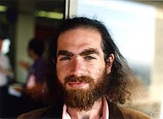
Is P = NP?
Any problem in P is also in NP:
P ⊆ NP
The big (and open question) is whether NP ⊆ P or P = NP
  i.e., if it is always easy to check a solution, should it also be easy to find a solution?
Most computer scientists believe that this is false but we do not have a proof …
Solve for a million dollars!
  http://www.claymath.org/millennium-problems
  The Poincare conjecture is solved today by
  Grigori Perelman (rejected the prize!) →
P
NP

Slide 27
What is not in NP?
Undecidable problems
  Given a polynomial with integer coefficients, does it have integer roots
  Hilbert’s nth problem
  Impossible to check for all the integers
  Even a non-deterministic TM has to have a finite number of states!
  More on decidability later
Tautology
  A boolean formula that is true for all possible assignments
  Here just one ‘verifier’ will not work. You have to try all possible values

Slide 28
NP-Completeness (informally)
NP-complete problems are
defined as the hardest
problems in NP.
Most practical problems turn out to be either P or NP-complete.
Study NP-complete problems …
P
NP-complete
NP

Slide 29
More Hard Computational Problems
Aerospace engineering: optimal mesh partitioning for finite elements.
Biology: protein folding.
Chemical engineering: heat exchanger network synthesis.
Civil engineering: equilibrium of urban traffic flow.
Economics: computation of arbitrage in financial markets with friction.
Electrical engineering: VLSI layout.
Environmental engineering: optimal placement of contaminant sensors.
Financial engineering: find minimum risk portfolio of given return.
Game theory: find Nash equilibrium that maximizes social welfare.
Genomics: phylogeny reconstruction.
Mechanical engineering: structure of turbulence in sheared flows.
Medicine: reconstructing 3-D shape from biplane angiocardiogram.
Operations research: optimal resource allocation.
Physics: partition function of 3-D Ising model in statistical mechanics.
Politics: Shapley-Shubik voting power.
Pop culture: Minesweeper consistency.
Statistics: optimal experimental design.

Slide 30
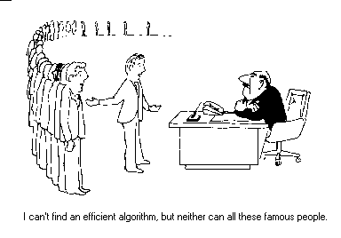
Practical Applications of NP-Completeness
I can’t find an efficient algorithm, but neither can all these famous people.
[Garey & Johnson, Computers and Intractability: A Guide to the Theory of NP-Completeness, Freeman, 1979.]

Slide 31
Become Famous!
To get famous in a hurry, for any NP-Complete problem:
  Raise the lower bound
  (via a stronger proof)
  Lower the upper bound
  (via a better algorithm)
They’ll be naming buildings after you before you are dead!

Slide 32
Reductions
Reduction is a way of saying that one problem is “easier” than another.
We say that problem A is easier than problem B, (i.e., we write “A ≤ B”)
if we can solve A using the algorithm that solves B.
Idea: transform the inputs of A to inputs of B
yes
α
f
β
Problem B
yes
no
no
Problem A

Slide 33
Polynomial Reductions
Given two problems A, B, we say that A is polynomially reducible to B (A ≤_{p} B) if:
  There exists a function f that converts the input of A to inputs of B in polynomial time
  A(i) = YES ⇔ B(f(i)) = YES
Is a linear equation reducible to a quadratic equation?
  Sure! Let coefficient of the square term be 0

Slide 34
NP-Completeness (formally)
A problem B is NP-complete if:
(1) B ∈ NP
(2) A ≤_{p} B for all A ∈ NP
If B satisfies only property (2) we say that B is NP-hard
No polynomial time algorithm has been discovered for an NP-Complete problem!
No one has ever proven that no polynomial time algorithm can exist for any NP-Complete problem
P
NP-complete
NP

Slide 35
Implications of Reduction
yes
α
f
β
Problem B
yes
no
no
Problem A
  - If A ≤_{p} B and B ∈ P, then A ∈ P
  - if A ≤_{p} B and A ∉ P, then B ∉ P

Slide 36
Proving Polynomial Time
Polynomial time algorithm to decide A
yes
α
f
β
Polynomial time
algorithm to decide B
yes
no
no
  Use a polynomial time reduction algorithm to
  transform A into B
  Run a known polynomial time algorithm for B
  Use the answer for B as the answer for A

Slide 37
Revisit “Is P = NP?”
Theorem: If any NP-Complete problem can be solved in polynomial time ⇒ then P = NP.
P
NP-complete
NP

Slide 38
P & NP-Complete Problems
Shortest simple path
  Given a graph G = (V, E) find a shortest path from a source to all other vertices
  Polynomial solution: O(VE)
Longest simple path
  Given a graph G = (V, E) find a longest path from a source to all other vertices
  NP-complete

Slide 39
P & NP-Complete Problems
Euler tour
  G = (V, E) a connected, directed graph find a cycle that traverses each edge of G exactly once (may visit a vertex multiple times)
  Polynomial solution O(E)
Hamiltonian cycle
  G = (V, E) a connected, directed graph find a cycle that visits each vertex of G exactly once
  NP-complete

Slide 40
Satisfiability Problem (SAT)
Satisfiability problem: given a logical expression Φ, find an assignment of values (F, T) to variables x_{i} that causes Φ to evaluate to T
  Φ =x₁ ∨ ¬ x₂ ∧ x₃ ∨ ¬ x₄
SAT was the first problem shown to be NP-complete!
x₁
AND
AND
x₂
NOT
OR
AND
x₃
NOT
OR
x₄
AND

Slide 41
CNF Satisfiability
CNF is a special case of SAT
Φ is in “Conjuctive Normal Form” (CNF) – Product of Sums
  “AND” of expressions (i.e., clauses)
  Each clause contains only “OR”s of the variables and their complements
  E.g.: Φ = (x₁ ∨ x₂) ∧ (x₁ ∨ ¬ x₂) ∧ (¬ x₁ ∨ ¬ x₂)
clauses

Slide 42
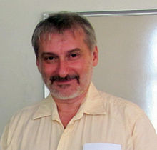
Cook’s Theorem
  By Stephen Cook and Leonid Levin (Turning Award Winners).
  Cook’s Theorem : SATISFIABILITY is NP-Complete.
  (The first NP-Complete problem)
  Instance : Given a set of variables, U, and a collection of clauses, C, over U.
  Question : Is there a truth assignment for U
  that satisfies all clauses in C?
Levin
If you want to see the proof it is Theorem 7.37 in Sipser (assigned reading!) or you can take an advanced course. You are not responsible for knowing the proof.
Cook in 1968

Slide 43
2-CNF SAT
Each OR operation has two arguments that are either variables or negation of variables
The problem in 2 CNF SAT is to find true/false(0 or 1) assignments to the variables in order to make the entire formula true.
Any of the OR clauses can be converted to implication clauses
(¬x∨y)∧(¬y∨z)∧(x∨¬z)∧(z∨y)

Slide 44
2-SAT is in P
Create the implication graph
¬x
y
x
¬y
¬z
z

Slide 45


Satisfiability via path finding
If there is a path from
And if there is a path from
Then FAIL!
How to find paths in graphs?
  DFS/BFS and modifications thereof

Slide 46
3-CNF Satisfiability(3 SAT)
A subcase of CNF problem:
  Contains three clauses
E.g.:
Φ = (x₁ ∨ ¬x₁ ∨ ¬x₂) ∧ (x₃ ∨ x₂ ∨ x₄) ∧ (¬x₁ ∨ ¬x₃ ∨ ¬ x₄)
3-CNF is NP-Complete
Interestingly enough, 2-CNF is in P!

Slide 47
3 CNF SAT
Not so easy anymore.
Implication graph cannot be constructed
No known polytime algorithm
Is it NP?
  If someone gives you a solution how long does it take to verify it?
  Make one pass through the formula and check
This is an NP problem

Slide 48
An example reduction
CLIQUE problem
A clique in an undirected graph is a subset of vertices such that each pair is connected by an edge

Slide 49
Clique
Clique Problem:
  Undirected graph G = (V, E)
  Clique: a subset of vertices in V all connected to each other by edges in E (i.e., forming a complete graph)
  Size of a clique: number of vertices it contains
Optimization problem:
  Find a clique of maximum size
Decision problem:
  Does G have a clique of size k?
Clique(G, 2) = YES
Clique(G, 3) = NO
Clique(G, 3) = YES
Clique(G, 4) = NO

Slide 50
5-Clique

Slide 51
Clique Verifier
Given: an undirected graph G = (V, E)
Problem: Does G have a clique of size k?
Certificate:
  A set of k nodes
Verifier:
  Verify that for all pairs of vertices in this set there exists an edge in E.
  We want to take a problem instance in 3-CNF SAT and convert it to CLIQUE finding.

Slide 52
3-CNF ≤_{p} Clique
Given – A boolean formula in 3 CNF SAT
Goal – Produce a graph (in polynomial time) such that
Idea:
We will construct a graph where satisfying formula with k clauses is equivalent to finding a k vertex clique.

Slide 53
Decision problems versus optimization problems
Finding the maximum sized clique is an optimization problem
But we can reduce it to a series of decision problems
  Can we find a clique of size 3 (why start at 3??)
  Can we find a clique of size 4
  Etc
In general in our study of NP etc, we will focus on decision problems

Slide 54
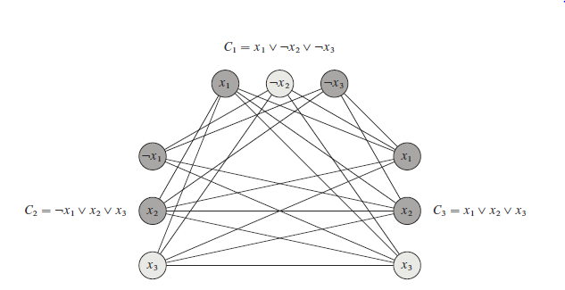
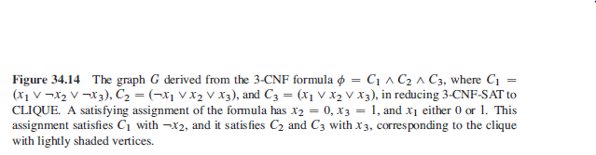
REDUCE 3-CNF SAT to CLIQUE
For each clause, create a vertex for each literal.
For the edges, Connect vertices if they come from different clauses, Even if the vertices come from different clauses, do not connect if it results in incompatibility. No variable should be connected to its not.

Slide 55
Other NP complete problems
Subset sum
Given a set of positive integers and some target t > 0, do we have a subset that sums up to that target set.
Why is the naïve algorithm going to be bad?

Slide 56
Subset Sum Problem
Subset Sum
Input: set X of non-negative integers, non-negative integer k
Question: Does X have a subset S such that ∑_{x in S} x = k ?
Example: X = { 1, 3, 3, 5, 7, 11, 17, 23, 41 }
and k = 25
S = { 3, 5, 17}

Slide 57
Theorem: Subset Sum is NP-complete
Proof.
Step 1: Select suitable NP-hard problem:
Circuit-Sat, SATISFIABILITY, 3-SAT, CLIQUE, Vertex Cover ?
3-SAT
Step 2: Give polynomial-time reduction from 3-SAT to Subset Sum
Have to convert 3-SAT instance to Subset-Sum instance.
WARNING: When converting to a problem involving numbers,
make sure that numbers do not become too large.
Explicitly work with binary (or base-10) representation.

Slide 58
A polynomial-time reduction from 3-SAT to Subset Sum
F: 3-SAT formula with clauses C₁,…,C_{m} over variables x₁,...,x_{n}
Convert F to set S of 2n+2m numbers, each consisting of n+m digits (base 10)
( First, remove clauses containing both x_{i} and ¬x_{i} for some i )
( x₁ V x₂ V ¬x₃) Λ (x₂ V ¬x₃ V ¬x₄) Λ (¬x₁ V ¬x₂ V x₄ )
 | x₁ | x₂ | x₃ | x₄ | C₁ | C₂ | C₃
v_{1,1} | 1 | 0 | 0 | 0 | 1 | 0 | 0
v_{1,2} | 1 | 0 | 0 | 0 | 0 | 0 | 1
v_{2,1} | 0 | 1 | 0 | 0 | 1 | 1 | 0
v_{2,2} | 0 | 1 | 0 | 0 | 0 | 0 | 1
c_{1,1} | 0 | 0 | 0 | 0 | 1 | 0 | 0
c_{1,2} | 0 | 0 | 0 | 0 | 2 | 0 | 0
v_{1,1} = 1000100
two numbers
per variable,
representing
TRUE and FALSE
two numbers
per clause
c_{1,2} = 0000200

Slide 59
 | x₁ | x₂ | x₃ | x₄ | C₁ | C₂ | C₃
v_{1,1} | 1 | 0 | 0 | 0 | 1 | 0 | 0
v_{1,2} | 1 | 0 | 0 | 0 | 0 | 0 | 1
v_{2,1} | 0 | 1 | 0 | 0 | 1 | 1 | 0
v_{2,2} | 0 | 1 | 0 | 0 | 0 | 0 | 1
c_{1,1} | 0 | 0 | 0 | 0 | 1 | 0 | 0
c_{1,2} | 0 | 0 | 0 | 0 | 2 | 0 | 0
v_{1,1} = 1000100
two numbers
per variable,
representing
TRUE and FALSE
two numbers
per clause
c_{1,2} = 0000200
target sum (k)
1 1 1 1 4 4 4
Lemma: F has satisfying assigment S has subset summing to 1…14…4
n times
must choose exactly one from each pair v_{i,1},v_{i,2}
for each clause, must make at least one literal TRUE;
if at least one literal TRUE, can select “clause numbers” to get to 4
m times

Slide 60
Theorem: Subset Sum is NP-complete
Proof.
Step 1: Select suitable NP-hard problem:
Circuit-Sat, SATISFIABILITY, 3-SAT, CLIQUE, Vertex Cover ?
3-SAT
Step 2: Give polynomial-time reduction from 3-SAT to Subset Sum
Can convert 3-SAT instance to Subset-Sum instance in
O((n+m)²) time, based on representation base-10.
Step 3. Prove Subset Sum in NP by giving polynomial-time verification algorithm.
certificate = subset summing to k.

Slide 61
NP-naming convention
NP-complete - means problems that are 'complete' in NP, i.e. the most difficult to solve in NP
NP-hard - stands for 'at least' as hard as NP (but not necessarily in NP);
NP-easy - stands for 'at most' as hard as NP (but not necessarily in NP);
NP-equivalent - means equally difficult as NP, (but not necessarily in NP);

Slide 62
Examples NP-complete and
NP-hard problems
NP-complete
NP-hard

Slide 63
The reducibility ‘tree’
Richard Karp proved 21 problems to be NP complete in a seminal 1971 paper
Not that hard to read actually!
Definitely not hard to read it to the point of knowing what these problems are.
karp's paper

Slide 64
Doing Your Homework
Think hard to understand the structure of both problems
Come up with a “widget” that exploits the structure
These are hard problems
Work with each other!
Advice from senior Students: PRACTICE THEM

Slide 65
Take Home Message
NP-Complete problems are the HARDEST problems in NP
The reductions MUST take polynomial time
Reductions are hard and take practice
Always start with an instance of the known NP-Complete problem
Next(Final) class: Some interesting discussions!

Slide 66
Papers
Read one (or more) of these papers:
  March Madness is (NP-)Hard
  Some Minesweeper Configurations
  Pancakes, Puzzles, and Polynomials: Cracking the Cracker Barrel
and Knuth’s Complexity of Songs
Each paper proves that a generalized version of a somewhat silly problem is NP-Complete by reducing 3SAT to that problem (March Madness pools, win-able Minesweeper configurations, win-able pegboard configurations)
Optional, but it is hard to imagine any student who would not benefit from reading a paper by Donald Knuth including the sentence, “However, the advent of modern drugs has led to demands for still less memory…”

Slide 67
References
Slides adapted from Prof. George Bebis, Univ of Nevada.
https://www.cse.unr.edu/~bebis/CS477/
Reference: Computers and Intractability: A Guide to the Theory of NP-Completeness
by Garey and Johnson, W.H. Freeman and Company, 1979.
A.K. Dewdney, The New Turning Omnibus, pp. 276-281, 357-362, Henry Holt and Company, 2001.
Goodrich & Tamassia, Algorithm Design, pp. 592-637, John Wiley & Sons, Inc., 2002.

Slide 68
A time of Gratitude
Almighty God in protecting in this uncertain times.
Your sincerity and dedication in learning and cooperation with me in this awesome course
Your great efforts and passion to explore the concepts in DSA and active participation in the class room
For your family members
You all proved that
simply GREAT!

Slide 69
Appreciations
Tough questions makes teaching interesting!
Token of appreciations for their active interaction in the classes (by way of questioning and answering)
- Arjun Sunil Nair
- Karthik Srinivas
- Hariharan
- Yash
- Rohan
- Aditya
- Shriram
- Shravani and few more…
You will get some gifts from me(not marks)

Slide 70
Appreciations
Toppers in CAT’s
CAT -1 – Vaibhave, Arush, Agniva
CAT-2 – Vaibhave & Suraj, Shyam & Yash, Sabrina (Desc – Arush, MCQ – Suraj and Tejaswi
Quizzes
DA’s

Slide 71
Preparing for FAT
HOW… WHAT to Learn?
Read the standard materials,
Text books,
My slides
NPTEL and MIT OCW videos
Have a planned schedule and focus on understanding the fundamental concepts,
Practice questions from,
Questions banks I provided
GATE questions
coding for exercises in book backs, standard institute’s assignment/exam questions

Slide 72
J Project
Appreciate your fantastic ideas/innovations
J-Review 3 date + Rubrics will be released soon.
20 marks for your understanding of basic concepts.
Focus on the fundamental concepts pertaining to your project as they are the building blocks/foundations for your project

Slide 73
Extra Miles…
Do Online coding,
Summer/Internship
Thon- events
Open project/Innovation competitions
Develop a website of your own – update achievements, solved problems with their codes
Build a CV first and connect in LinkedIn…

Slide 74
Online survey for this course!
Thank You for filling the online survey.
Will be useful to improve the Teaching-Learning process for this course, in the future.

Slide 75
A Big Thanks!
Prof. George Bebis
CLRS
Sadagopan, IIITDM
Sartaj Sahni,
MA Weiss

Slide 76

Love DSA always!☺, there is a better career…

Slide 77
Keep in Touch
Email : oswald.mecse@gmail.com
oswald.c@vit.ac.in
Website: https://oswaldc.netlify.app/

Slide 78
Photo Session…

